Slide 1

Matplotlib: A History
Subtitle goes here

Slide 2
The Dongle Problem

Slide 3
MATLAB Graphics API
Simple, convenient plot commands: plot()
Arguments for simple customization: ‘r--’
Rich, structured API to access lower level functionality (axes, tick generators, etc)
Great!

Slide 4
MATrix LABoratory for large applications…
Notes:
doesn’t work. enter python, general purpose language based on C started in 1989
designed to extensible!

Slide 5
Notes:
interfaced with GTK+ for linux
http://www.aosabook.org/en/matplotlib.html

Slide 6
Matplotlib: today
scripting
artist
backend

Slide 7
Matplotlib: today
pylab interface
matplotlib API
backends
Notes:
other names for the same things
top level is what you get with pylab (scipy), pandas

Slide 8
Backends
PS
SVG
AGG
GTK
GTKAgg
PDF
wxWidgets
…etc
Notes:
PS – postscript
SVG - …
AGG – anti-grain geometry
GTK – gimp tool kit

Slide 9
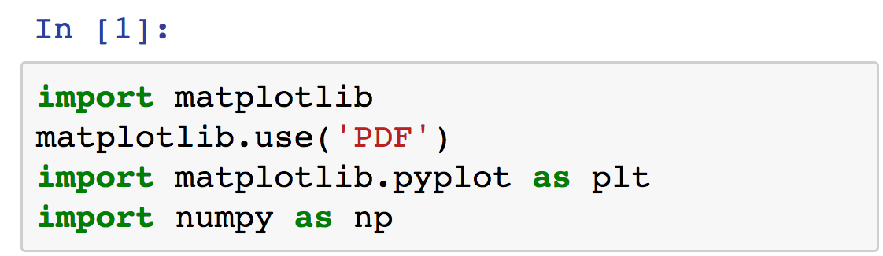
Selecting a backend
Depends on your OS…
(Default: AGG)
* select before loading pyplot to have effect

Slide 10
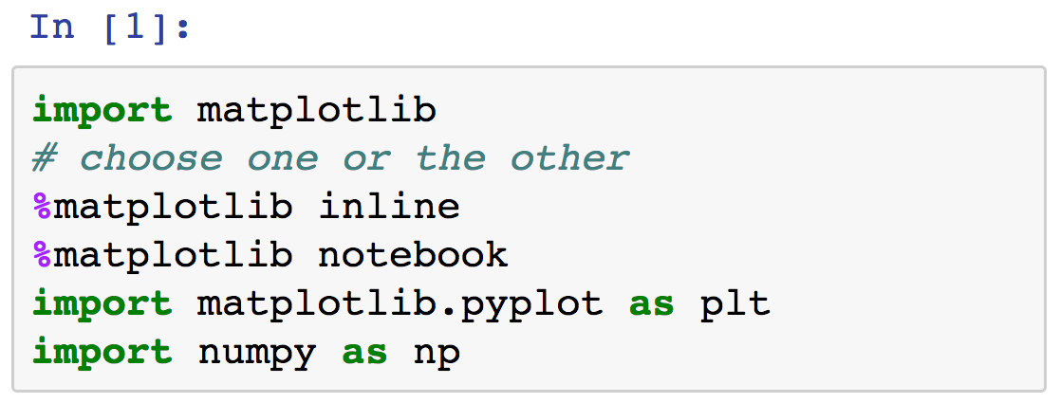
Inside Jupyter…
There’s a twist:

Slide 11
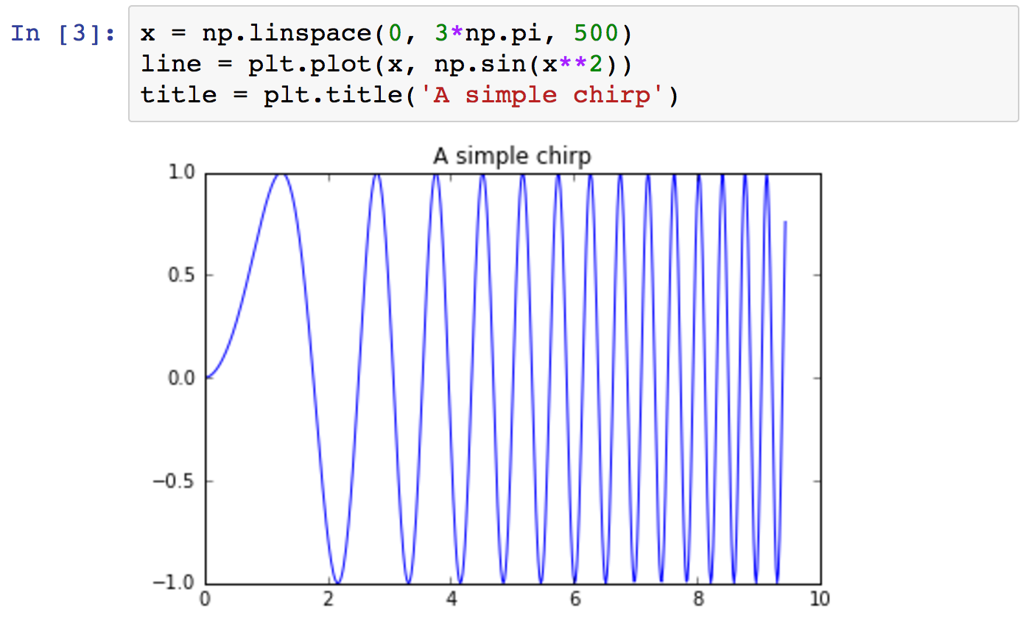
Inline:

Slide 12
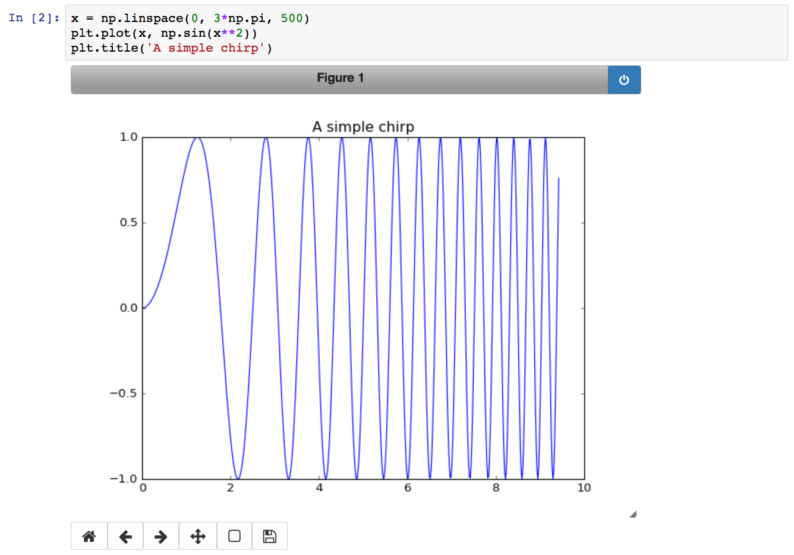
Notebook:
* only works if notebook run locally, uses Qt

Slide 13
Wrapping it back to Jupyter
Notes:
How the PNG produced gets loaded back into the browser

Slide 14
Matplotlib API (Artist)
3 pieces!
Notes:
also, the “artist” layer

Slide 15
Matplotlib API (Artist)
matplotlib.backend_bases.FigureCanvas
area onto which the figure is drawn
Notes:
also, the “artist” layer

Slide 16
Matplotlib API (Artist)
matplotlib.backend_bases.FigureCanvas
area onto which the figure is drawn
matplotlib.backend_bases.Renderer
knows how to draw on the FigureCanvas
Notes:
also, the “artist” layer

Slide 17
Matplotlib API (Artist)
matplotlib.backend_bases.FigureCanvas
area onto which the figure is drawn
matplotlib.backend_bases.Renderer
knows how to draw on the FigureCanvas
matplotlib.artist.Artist
knows how to use a renderer to paint onto the canvas
Notes:
also, the “artist” layer

Slide 18
Matplotlib API (Artist)
matplotlib.backend_bases.FigureCanvas
area onto which the figure is drawn
matplotlib.backend_bases.Renderer
knows how to draw on the FigureCanvas
matplotlib.artist.Artist
knows how to use a renderer to paint onto the canvas
Notes:
also, the “artist” layer

Slide 19
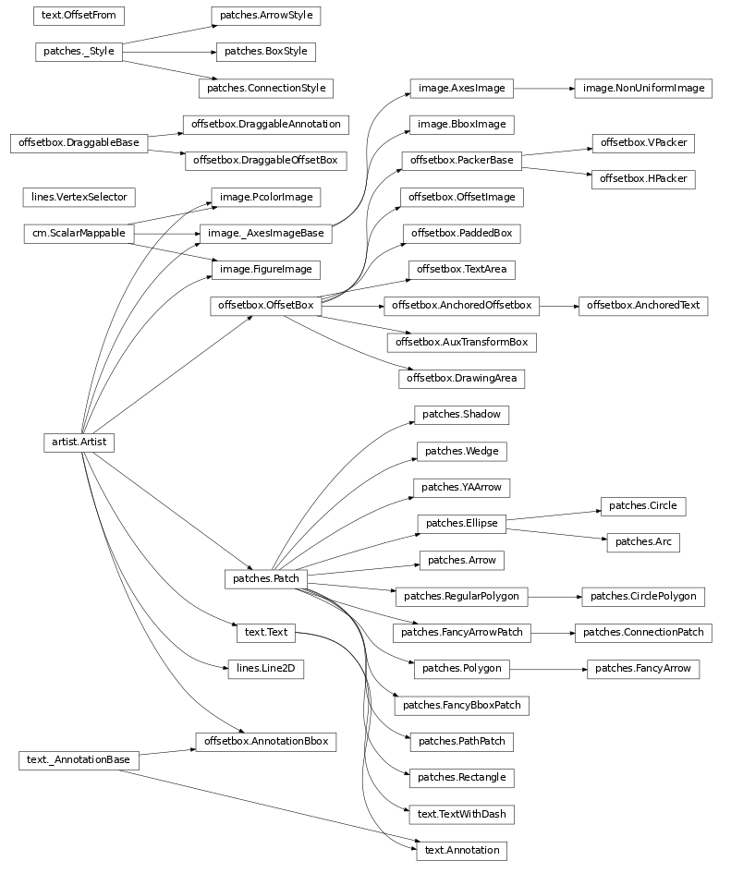
Notes:
http://matplotlib.org/api/artist_api.html#matplotlib.artist.Artist

Slide 21
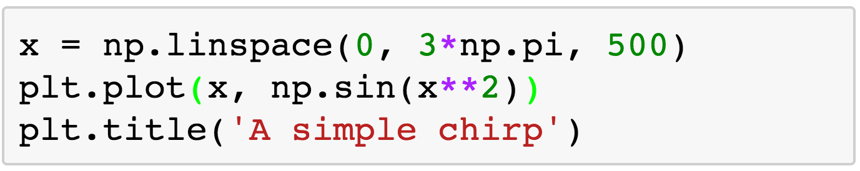
Interacting with the Artist
This is up at the scripting (pyplot) level:

Slide 22
Where the artists live

Slide 23
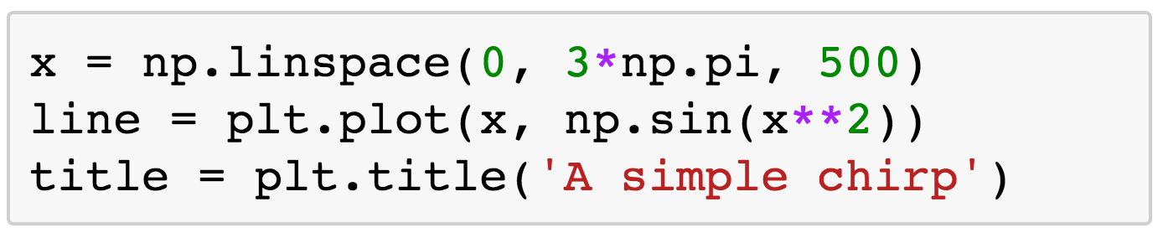
Where the artists live

Slide 24
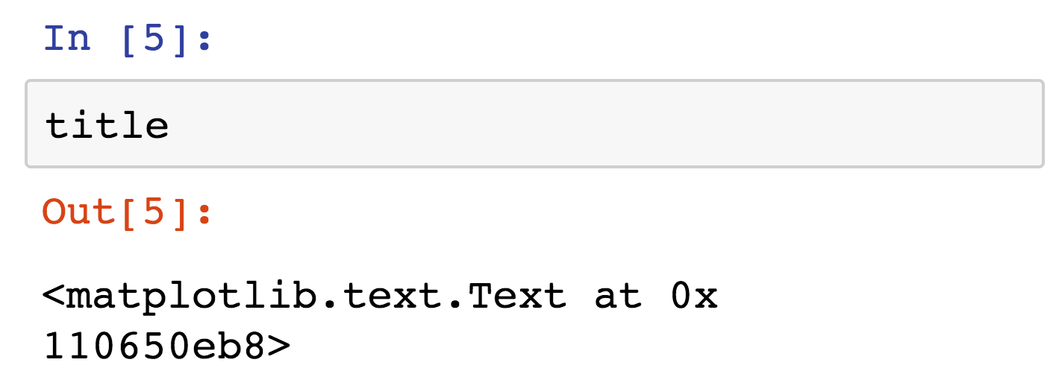
Where the artists live

Slide 26
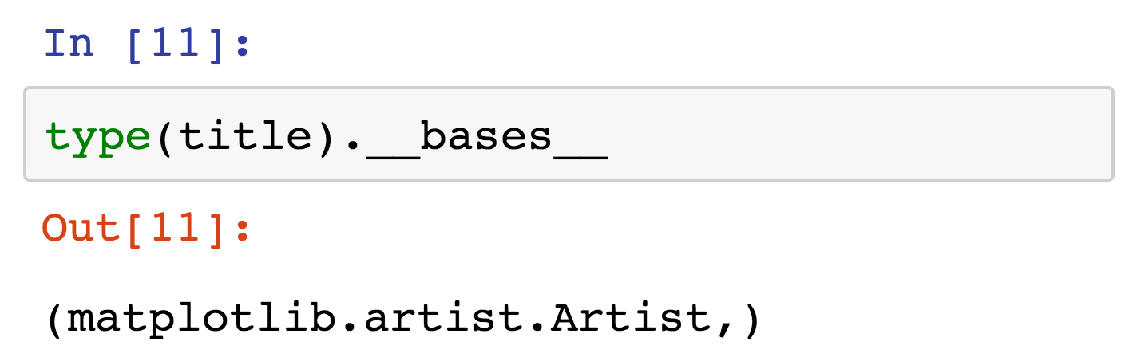
How to check?

Slide 27
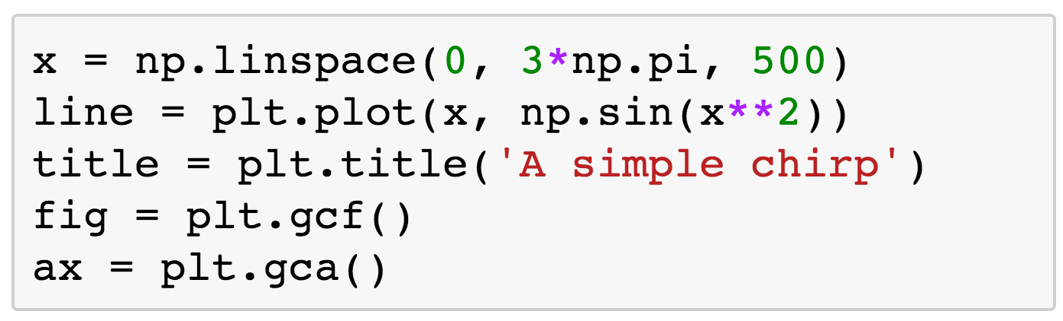
What about the figure, axes?
Notes:
that was a bit backwards, but there they are!

Slide 28
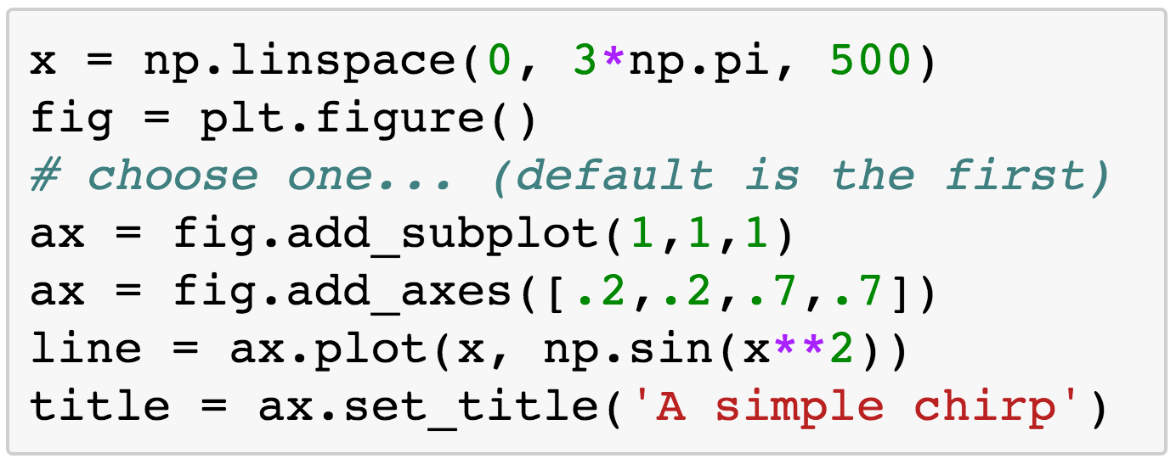
Not in reverse…

Slide 29
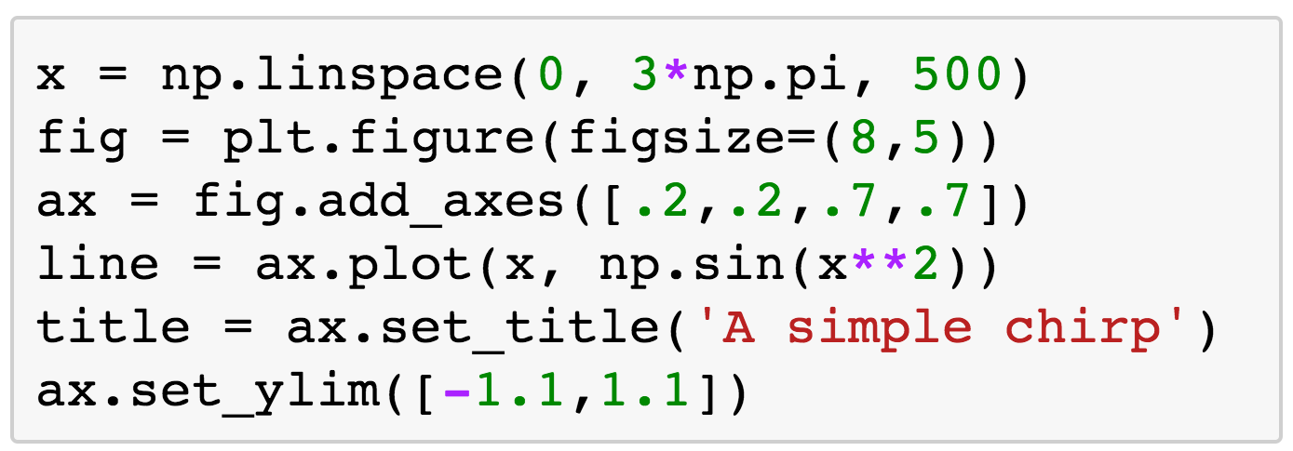
Now we can get more specific

Slide 30
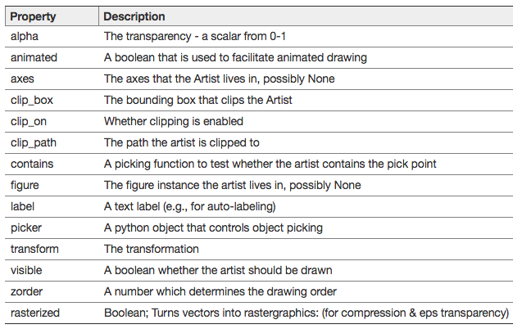
Every artist inherits these:

Slide 31
Why axes?
“The matplotlib.axes.Axes is the center of the matplotlib universe”
-The Docs

Slide 32
Tips
Use figsize wisely: always work at final size.

Slide 33
Tips
Use figsize wisely: always work at final size.
Notes:
From before. You can’t read the ticks and title!

Slide 34
Tips
Use figsize wisely: always work at final size.
Work with axes objects to build custom plots.
Notes:
From before. You can’t read the ticks and title!

Slide 35
Tips
Use figsize wisely: always work at final size.
Work with axes objects to build custom plots.
Keep track of styles in a stylesheet (more next!).
Notes:
From before. You can’t read the ticks and title!

Slide 36


Slide 37
Defining your own stylesheet
Subtitle goes here

Slide 38
Reference: the docs
http://matplotlib.org/users/customizing.html
and
http://matplotlib.org/users/style_sheets.html#style-sheets

Slide 39
Case study: publication
Dodds, et. al., publish Human language reveals a universal positivity bias in PNAS.
Refuted by Garcia, et. al., in The language-dependent relationship between word happiness and frequency.
Goal: show that three data sets of word positivity are correlated!

Slide 40
Starting point

Slide 41
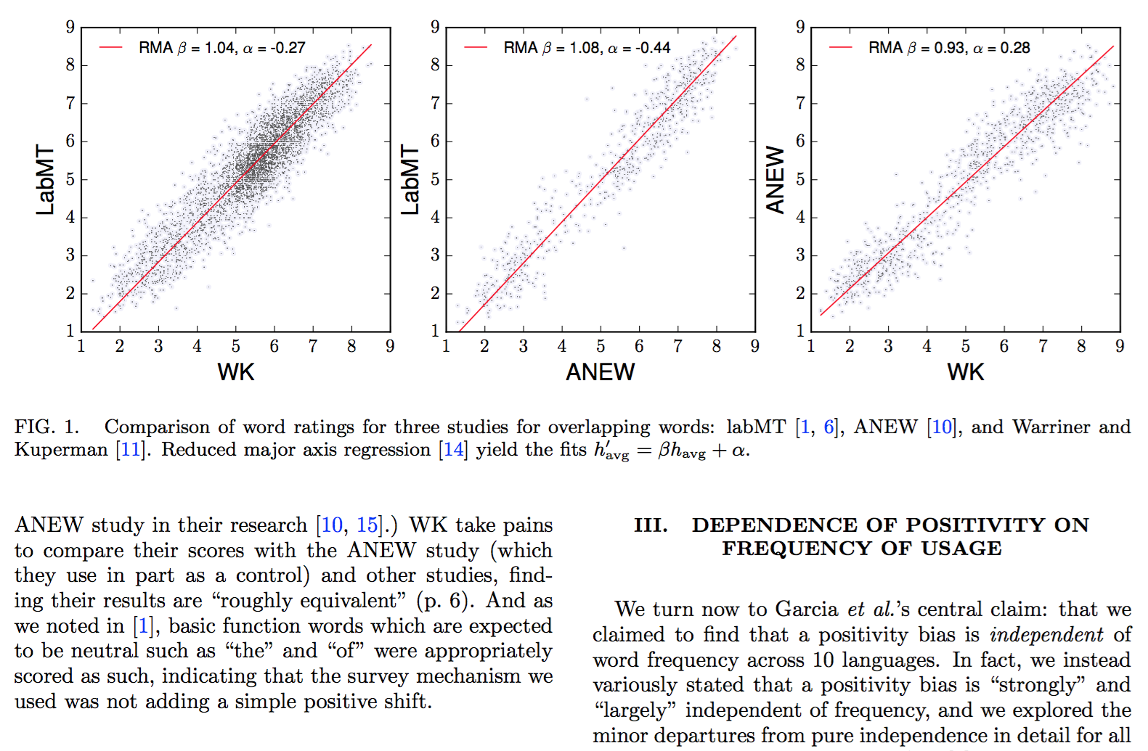
Published

